Slide 1
Ergonomics at a DESK

Slide 2
Safe Lifting Techniques

Slide 3
Safe Lifting Techniques

Slide 4
COVID-19
Notes:
COVID-19 Protections
Coronavirus Disease 2019 (COVID-19) is a respiratory disease. The virus is spread mainly from person-to-person, including:
Between people who are in close contact with one another (within about 6 feet).
Through respiratory droplets produced when an infected person coughs or sneezes.
It may be possible that a person can get COVID-19 by touching a surface or object that has SARS-CoV-2 on it and then touching their own mouth, nose, or possibly their eyes, but this is not thought to be the primary way the virus spreads.
People are most contagious when they are experiencing fever, cough, and/or shortness of breath. Some spread is possible before people show symptoms.
The first step employers need to take to protect employees from COVID-19 is to identify the potential sources of exposure. Employers need to think about:
whether members of the public enter the workplace,
whether employees are coming to work sick,
how close workers are working to each other,
and what the hygiene practices in the workplace are, etc.
What are some things employers can do to keep employees safe from COVID-19
Promote frequent and thorough hand washing by providing workers, customers, and worksite visitors with a place to wash their hands. If soap and running water are not immediately available, provide alcohol-based hand rubs containing at least 60% alcohol.
Encourage workers to stay home if they are sick.
Provide workers with masks and make sure they wear them.
Ensure that workers are spaced apart while working (at least 6 feet apart)
Discourage workers from using other workers’ phones or work tools and equipment, when possible.
Maintain regular housekeeping practices, including routine cleaning and disinfecting of surfaces, equipment, and other elements of the work environment.
Safety Data Sheets
Follow the manufacturer’s instructions for use of all cleaning and disinfection products (e.g., concentration, application method and contact time, PPE).
Where appropriate, they can install high-efficiency air filters and increase ventilation rates in the work environment.

Slide 5
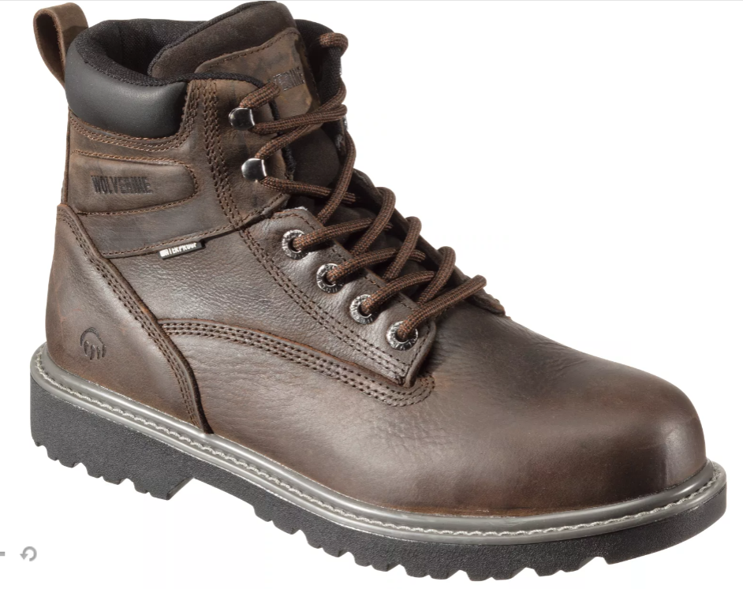
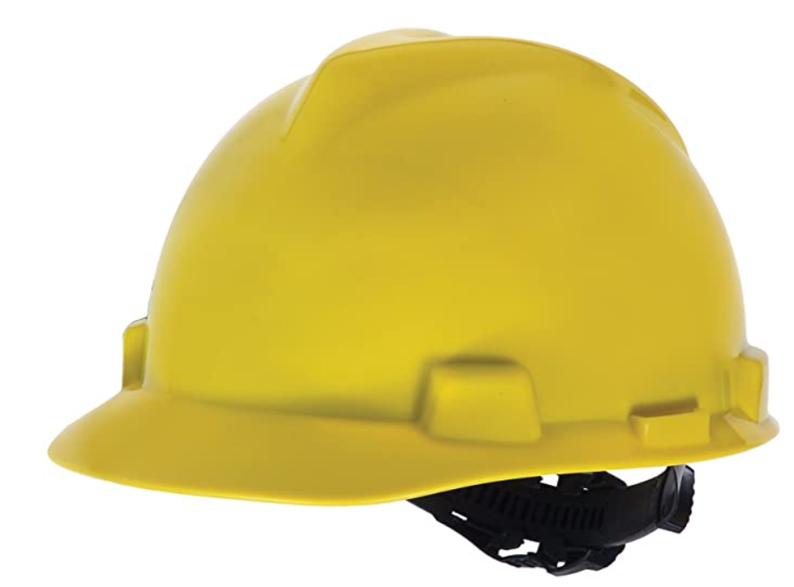
What is the PPE?

Slide 6
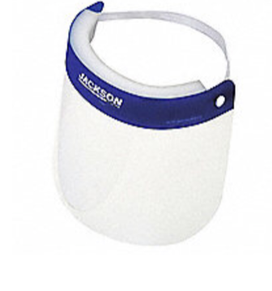
What is the PPE?

Slide 7
What is the PPE?

Slide 8
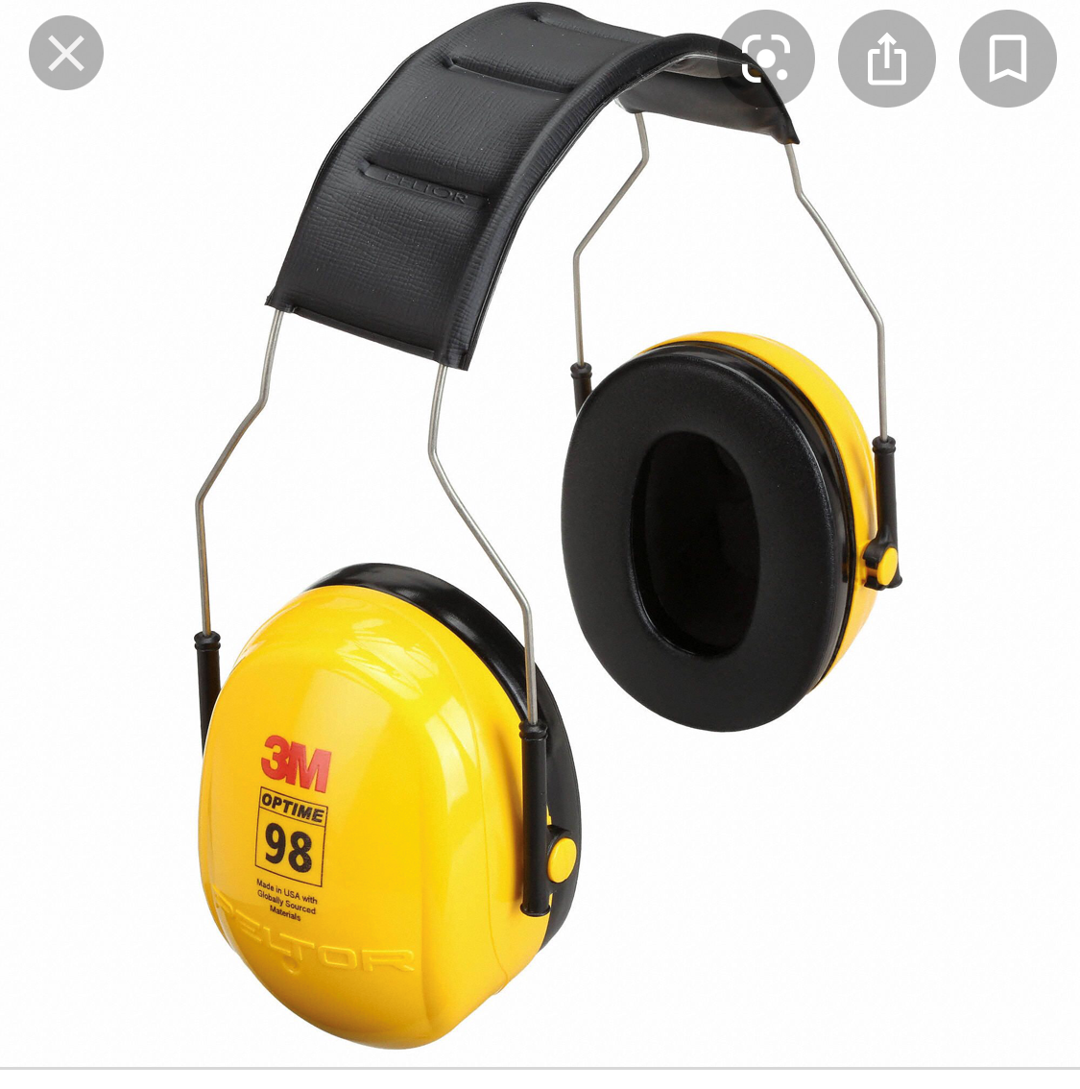
What is the PPE?

