Slide 1


Navigating College Relationships
A guide to connection and growth

Slide 2

DHHS Statement about Content
USNH Collegiate Recovery is supported under a Contract with the State of New Hampshire, Department of Health, and Human Services. The contents of this presentation are those of the author(s) and do not necessarily represent the official views of, nor an endorsement, by CDC/HHS, or the U.S. Government.

Slide 3




Meet Today’s Panelists
Kathleen Grace-Bishop
Director of Education & Promotion, Health & Wellness
Katie Bartholomew
Director of Residential Life
Rachel Stewart
Director of the SHARPP Center
Kally Walker
Assistant Director of the Memorial Union & Student Activities

Slide 4


Goals for Today’s Session
  To provide guidance for parents, families, and caregivers to support their students through the challenges and triumphs of collegiate relationships and friendships.
  To give parents, families, & caregivers resources that their students can lean on at UNH.
  To answer any questions you may have about connection and community at UNH.

Slide 5
General Tips for
"Tough" Conversations
(aka conversations that matter)
  Use "open-ended" questions
  Listen more than you speak
  Be genuine & seek connection
  Suspend judgement
  Honor autonomy and their emerging adulthood
    Tune into your "fixing" reflex
Adapted from: "Talking with Your Teen: 10 Tips for Meaningful Connection." The Gottman Institute. https://www.gottman.com/blog/talking-with-your-teen-10-tips-for-meaningful-connection/ &
"10 Tips for Talking to Your Teen About Their Mental Health." The JED Foundation.
https://jedfoundation.org/resource/tips-for-talking-to-your-teen-about-their-mental-health/
Notes:
Rachel's content

Slide 6
Framework for Today’s Conversation
Campus Involvement
MUB & Student Activities
Roommate Relationships
Residential Life
Interpersonal Relationships
Health & Wellness
The SHARPP Center

Slide 7

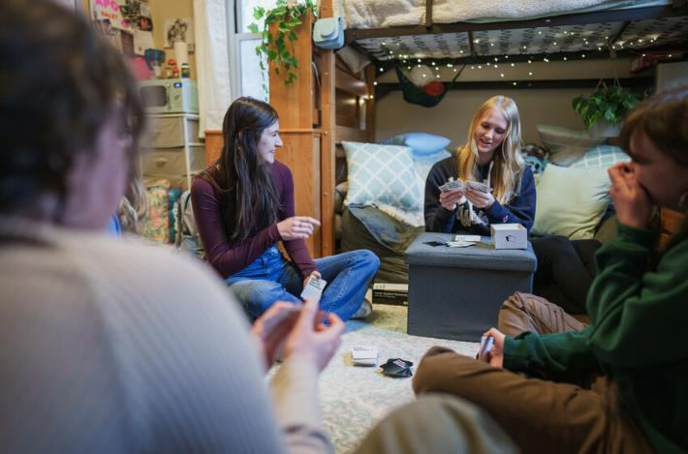
Romantic Relationships

Slide 8

Talking to Your Student About Sex and Relationships
  Increased communication = increased connection (Morgan, Thorn, & Zubriggen, 2010).
    Trust your gut and build on your existing relationship!
    Communication about sex and relationships increases likelihood of safer sex practice and positive relationship outcomes
    Consistency is key!
  Living Well Services
    Sexual Well-Being programming, Sexual Well-Being Coaching, Wellness Coaching
Notes:
A 2017 longitudinal study shows that parents and caregivers who talked to their students about sex and relationships consistently over their 4 years in college found an increased closeness in their overall relationship and a reduced sense of awkwardness in those conversations
There's no one right way to have those conversations – a lot of it depends on the groundwork that's already been laid and the culture of your existing relationship. Similarly, what you say depends on your own beliefs and worldview. Asking open ended questions, allowing your student to try things out without shame or judgment, and cultivating a safe space for your student to process their experiences are the best things you can do.
The NCHA 2023 data shows that 50% of first year students are not sexually active – instead, they're less occupied with sex and dating and more focused on friendships, themselves, and connections made through their phone. Similarly, national data shows first year college students are less likely to enter into relationships than ever before. Just because data shows students are less likely to be having sex or entering into relationships doesn't mean they aren't thinking about it, impacted by others around them being in relationships, or that they aren't curious about it. Talking about it, asking about it in open ended ways, and reminding students that you are there for them – even if it's awkward at first – are some of the best ways you can show up for them.

Slide 9
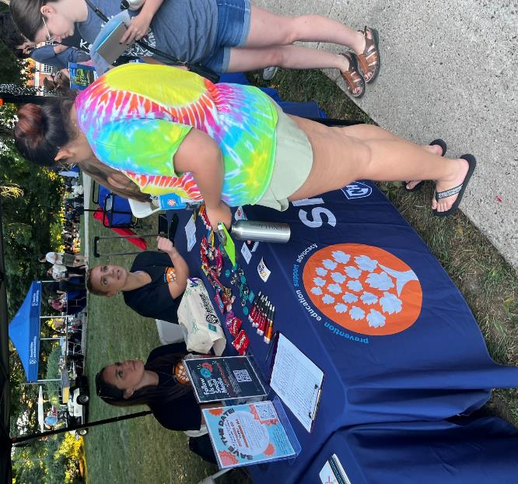
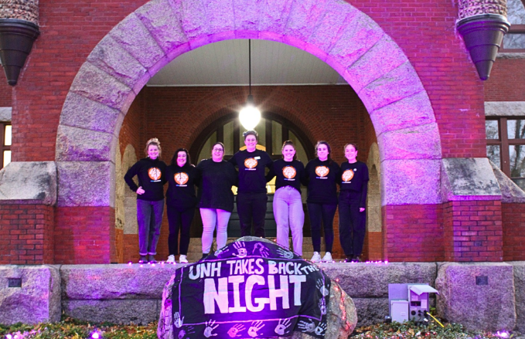


SHARPP Center Resources
Education & awareness-raising for students across the university
Emphasis on meeting students where they are & healthy behaviors across all types of relationships
24/7 help and support from trained Advocates
  Relationship & consent questions or concerns
  Support & resources for friends, roommates, partners, parents
  Phone line & daily drop-in hours on weekdays
Involvement Opportunities
  Volunteer positions
  Internships
  Ability to be trained as a certified NH Crisis Counselor
  Popular opportunity for students interested in careers in public health, medicine, social work, counseling, and/or education
  A community of support and like-minded students, supported by professional staff!
unh.edu/SHARPP | 24/4 Confidential Help & Support Line: (603) 862-7233

Slide 10
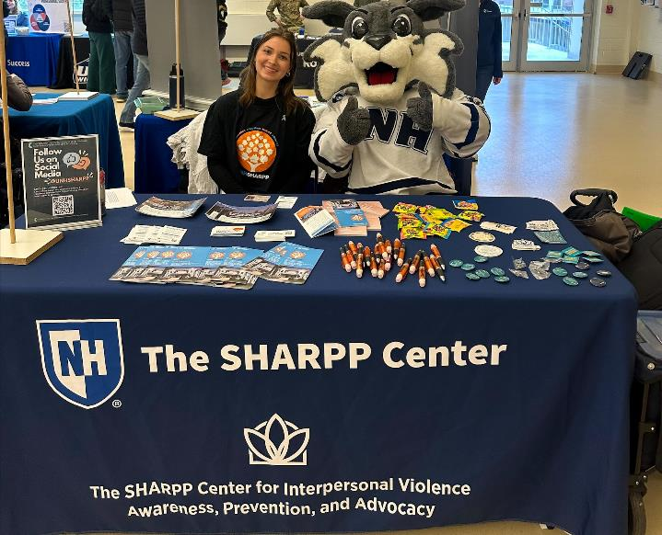

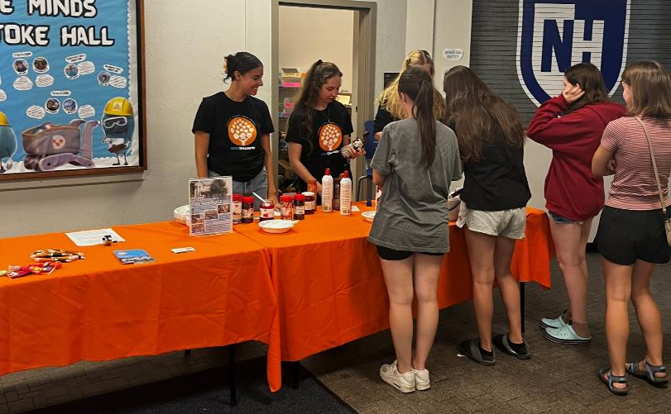
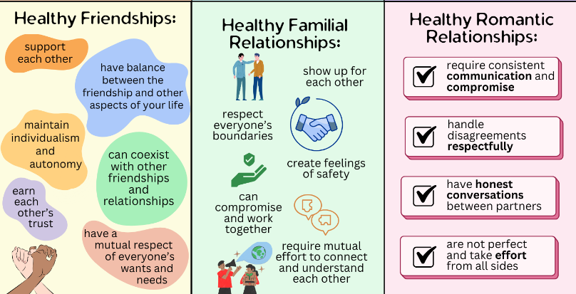

Our Lens on Prevention:
Consent:
  A tool for life and all kinds of relationships, not just romantic or sexual ones
  Education through formal workshops like “Wildcats Get Consent”
  and interactive activities such as our Consent Ice Cream Sundae Bar,
  “Hot n’ Ready: The Pizza-Consent Connection”, & “Connecting the
  Pieces: Consent-Based Teambuilding Activity”
Healthy Relationships:
Bystander Intervention:
Taught through workshops like “You Can Help” & “Preventing Harm in Your Role”
Scenario & culture-based activities like SHARPP Jenga
unh.edu/SHARPP | 24/4 Confidential Help & Support Line: (603) 862-7233
Notes:
Healthy Relationships Flyer description:
Healthy Relationships:
Support each other
Have balance between the friendship and the other aspects of your life
Maintain individualism and autonomy
Can coexist with other friendships and relationships
Earn each other's trust
Have a mutual respect of everyone’s wants and needs
Healthy familial relationships:
Show up for each other
Respect everyone's boundaries
Create feelings of safety
Can compromise and work together
Require mutual effort to connect and understand each other
Healthy romantic relationships
Require consistent communication and compromise
Handled disagreements respectfully
Have honest conversations between partners
Are not perfect and take effort from all sides

Slide 11

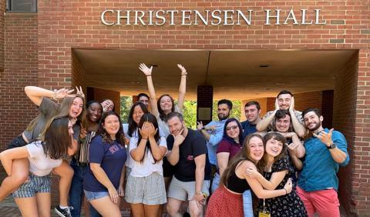
Roommate
Relationships
Notes:
50% go random

Slide 12
Let’s Talk Housing App
& Roommates
  UNH has a 2 year live on requirement
    2nd year students may request an exception
  Roommates
    Going in with a roommate vs going random, our students feel 50/50
    Students will fill out roommate contracts to ensure they are setting healthy boundaries and openly communicating
    Success is dependent on communication
Notes:
50% go random

Slide 13
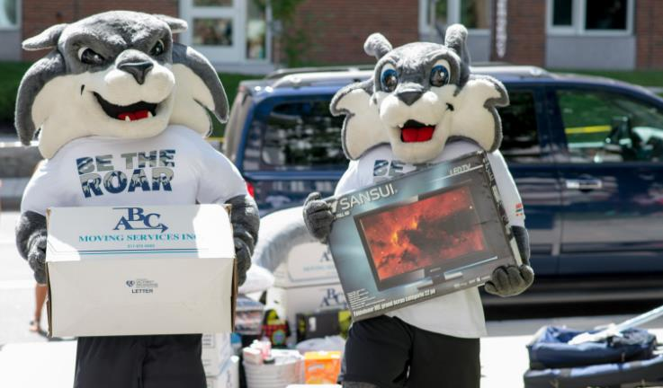
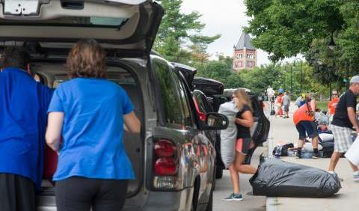
Moving into
Wildcat Country
Move-in is either Thursday or Friday, depending on the building you live in:
  August 21 & August 22 Thursday Odd Day Odd Floors
Moving into students rooms
  Each room has a twin XL bed, desk with chair, & dresser
  Students are encouraged to chat with roommates about mini-fridges/microwaves/televisions
  Packing list do’s and don’ts available on Housing website
Timeslots: These will be emailed to students by the end of July. You will also be emailed when your move-in day and time are.

Slide 14
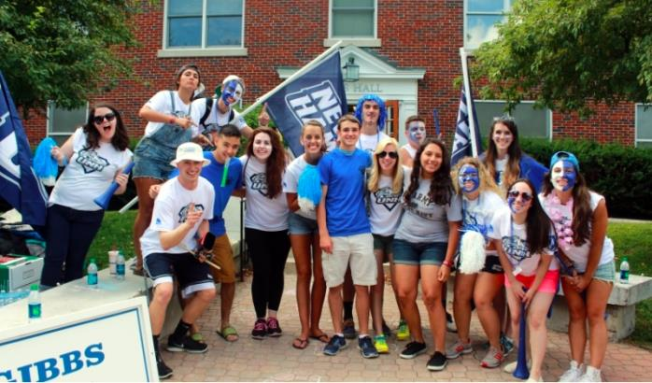
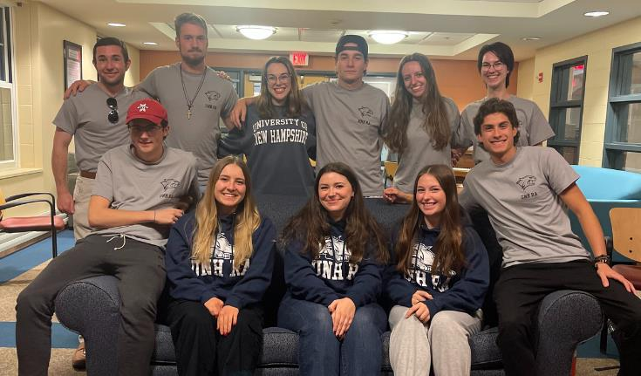
UNH is Your Home Away From Home
Hall Information
  Every hall/area is equipped with a live-in professional & student staff members
  Social & Educational programming takes place in halls on a weekly basis
  Residence Halls will likely be students first community, encourage them to open their doors, attend programming, and get involved!

Slide 15


Making Connections in the First Few Weeks
Upcoming Events
  Wildcat Days: August 22nd- 24th
    Find your Fit: August 24th
  University Day (U-Day): September 4th
Look for communities that interest you
  Attend an intro meeting
  Cheer on a Wildcat athletic team
  Explore campus and downtown Durham
  Apply for an on-campus job
  Speak with a professor about research opportunities
Involvement looks different for everyone!
Notes:
FSL

Slide 16
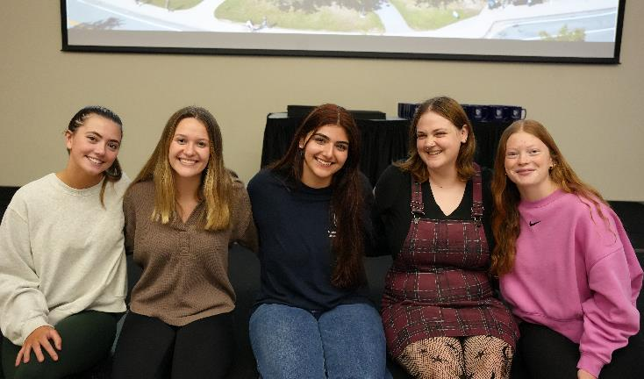
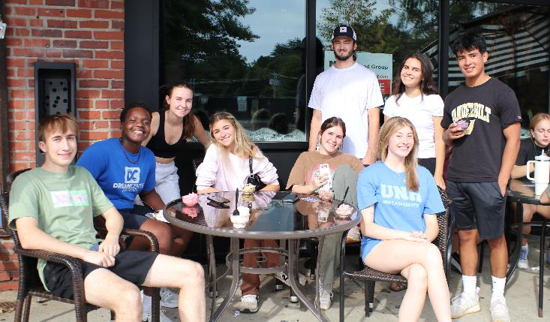
What to Do If My Student is Struggling to Connect
Ways to Support your Student
  Normalize the experience of "finding your people"
  Encourage small, intentional actions
  Prioritizing meaningful relationships over popularity
  Additional Strategies
    Determine your student's need: validation, advice, etc.
    Campus Resources

Slide 17

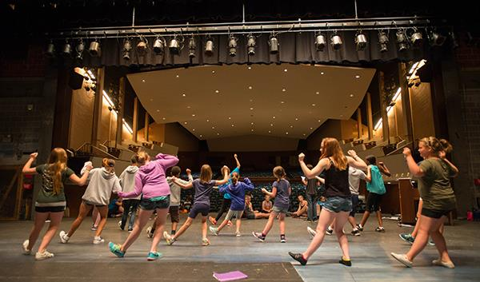
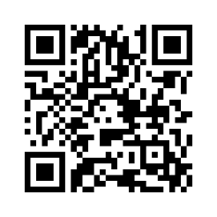
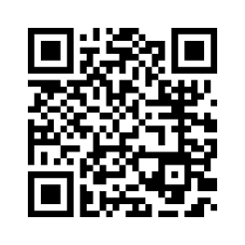
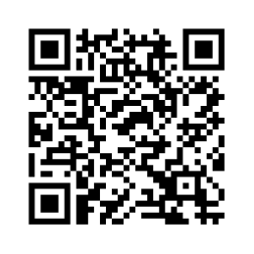
Stay Informed!
Find out what’s happening on campus
  Instagram accounts (@UNHStudents)
  Academic College websites
  Catalyst
Instagram
Academic Colleges
Get Involved!
Notes:
@unh Students; https://www.instagram.com/unhstudents/
Academic Colleges websites : https://www.unh.edu/academics/colleges-schools
Getting Involved: https://www.unh.edu/mub/student-organizations/getting-involved

Slide 18

Thank You
We have so enjoyed speaking with you all this afternoon.
Welcome to the University of New Hampshire family!

