Slide 1
Foundational Participatory Research to Inform Measurement and Guidance for Addressing Food Security Among People with Intellectual and Developmental Disabilities (IDD)
Acknowledgements: This work is supported by the Agriculture and Food Research Initiative Foundational and Applied Science Program, project award no. 2024-69015-42299, from the U.S. Department of Agriculture’s National Institute of Food and Agriculture.
Notes:
-Thanks for being here today
-I’m going to give an overview of food is medicine interventions

Slide 2
Research staff
University of New Hampshire, Institute on Disability
Debra L. Brucker, MPA, PhD
Hyun Ju Kim, PhD
Karen Volle, BA
Center for Nutrition and Health Impact
Eric Calloway, PhD, RD
Grace Stott, MPH
Acknowledgements: This work is supported by the Agriculture and Food Research Initiative Foundational and Applied Science Program, project award no. 2024-69015-42299, from the U.S. Department of Agriculture’s National Institute of Food and Agriculture.
Notes:
-Thanks for being here today
-I’m going to give an overview of food is medicine interventions

Slide 3
Nutrition Security & Food Security
Quantity vs quality
“…access … to enough food for an active, healthy life.”
- USDA
Food Security
Nutrition Security
“…access to healthy, safe, affordable foods essential to optimal health and well-being.” - USDA

Slide 4
Health Risks
High blood pressure
High cholesterol/lipids
Diabetes
Excess weight
Chronic kidney disease
Depression, anxiety, and sleep disorders
Arenas et al., 2019; da Silva Miguel, et al., 2020; Ferrara et al., 2024

Slide 5
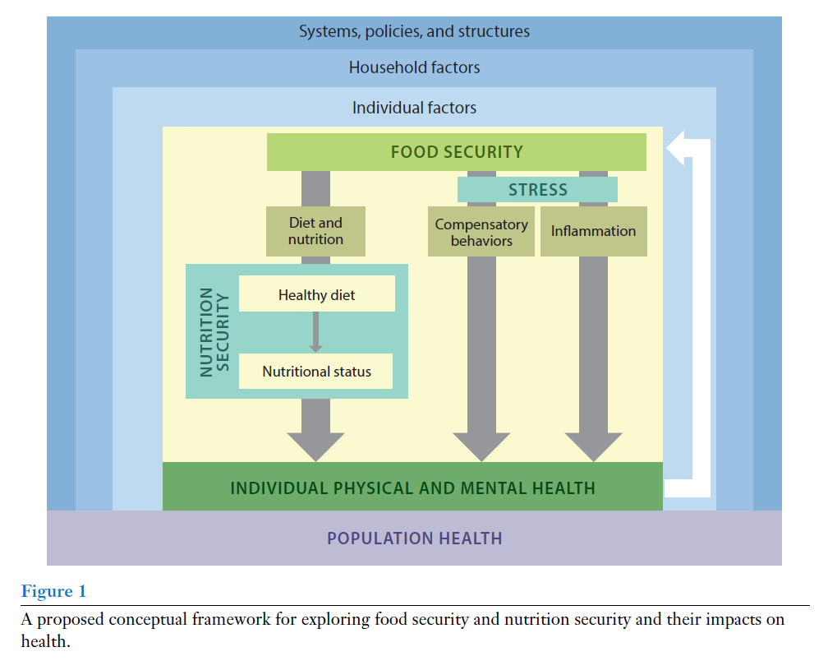
Mechanisms of Health Impacts
Stress
Trade-offs
Inflammation
Dietary compromises
Nutritional status
Seligman, et al. Annu. Rev. Nutr. 2023. 43:409–29
Notes:
-This mechanistic pathway helps explain how food and nutrition security impact health
-Food security affects health through both psychosocial stress and physiological stress
-Leading to compensatory behaviors, such as forgoing medication to afford food, and also systemic inflammation
-Also, food security and nutrition security lead to dietary compromises, such as buying less healthful food and worsening nutritional status

Slide 6
How we measure it
USDA Household Food Security Survey Module
18 survey questions
Asks about not being able to afford enough food and experiencing worry, hunger, and coping behaviors.
Included in national public health surveillance surveys (e.g., Current Population Survey) and used extensively in research.
Notes:
-Mention some work done with physical disability, none with intellectual

Slide 7
Food Security Among People with Disabilities
Increased risk of food insecurity among households with someone with a disability: 18% vs. 9%
Risk factors go beyond economics: interaction of individual factors (e.g., activity or functional limitations) with structural factors (e.g., inaccessible grocery stores, lack of appropriate transportation.
Persons with Intellectual or Developmental Disabilities (IDD) have cognitive and functional limitations which start any time before a child turns 18 years old.
Higher risk of food insecurity (i.e., traditional economic measures) for young adults with IDD (OR: 2.90, p<.001) than others without IDD even when controlling for poverty.
Henly et al., 2023; Brucker et al., 2015; Heflin et al., 2007; Huang et al., 2010; Brucker and Nord, 2016; NIH, 2021

Slide 8
Food Access Barriers for People with IDD
Differences in intellectual functioning or intelligence and may also include physical differences in functioning (e.g., seizures, trouble with movement, sensory disorders, metabolic issues).
Economically disadvantaged, low employment rates, and higher overall poverty risk.
Structural barriers in accessing community-based nutrition assistance services.
Challenges with shopping, safely storing, or preparing due to the interaction of the functional and activity limitations with structural factors.
Newacheck and Kim, 2005; Parish and Cloud, 2006; Parish et al., 2010; Emerson, 2007; Keller et al., 2007; Karpur et al., 2021
Notes:
Persons with IDD have cognitive and functional limitations which start any time before a child turns 18. These disabilities can include differences in intellectual functioning or intelligence and may also include physical differences in functioning (e.g., seizures, trouble with movement, sensory disorders, metabolic issues).¹³ Persons with IDD are at higher risk for diabetes, high cholesterol, and obesity than the general population.¹⁴ Persons with IDD are economically disadvantaged, facing extra expenses due to the need to purchase adaptive technologies, supportive services, and medical care,^{15–17} low employment rates (both for individuals with IDD and their family members),¹⁷ and higher overall poverty risk.¹⁸ Food insecurity rates for adults with IDD, measured using traditional economic measures, are higher than rates for persons without IDD.¹⁹ Persons with IDD may experience structural barriers in accessing community-based nutrition assistance services, although further research is needed.^{20,21} Anecdotal information from UNH-IOD programs that serve persons with IDD indicates that current community level food and nutrition assistance supports are not adequately targeted towards this population.
For the past 25 plus years, food security and food insecurity have been operationalized and measured in the U.S. as being related to financial access to “enough food,” using the U.S. Department of Agriculture’s Household Food Security Survey Module.²² Basing nutrition assistance program and policy development on this type of measure assumes that issues of food security can be addressed by providing free or reduced cost food or in-kind support (e.g., SNAP). An economic measure of food security, however, and its related policies do not address the interaction of individual and structural factors that may contribute to increased rates of food insecurity among people with IDD. For example, people with IDD may face challenges in shopping for, safely storing, or preparing food, even when they have enough economic resources, due to the interaction of their functional and activity limitations with structural factors. Developing a targeted measure of food security for people with IDD that goes beyond measuring economic access to food and takes these issues into account is important for developing effective guidance for policy and practice.

Slide 9
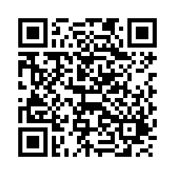
Our Study Goals
Inclusive Food Security for People with IDD (IFIDD)
Objective 1: Collect and analyze interview data from approximately 30 people with IDD and their family members to understand how food insecurity is experienced in an IDD context and the unique strengths and challenges relevant to this population.
Objective 2: Use the formative study findings to co-develop a preliminary measurement tool and guidance document to help organizations better understand, identify, measure, and develop interventions and programming to address food insecurity among people with IDD and their families.
We are recruiting interviewees!
Follow this link to the enrollment form.

Slide 10
Our Study Activities and Timeline (1)
We are recruiting interviewees!
Follow this link to the enrollment form.

Slide 11
Our Study Activities and Timeline (2)
Assembling advisory group
Drafting interview guides
Meeting with advisory group to finalize guides
Getting IRB approvals
We are recruiting interviewees!
Follow this link to the enrollment form.

Slide 12
Our Study Activities and Timeline (3)
Conducting interviews
Thematic analysis
Present findings to advisory group and discuss interpretations/framing
Disseminate scientific and plain-language versions of findings
We are recruiting interviewees!
Follow this link to the enrollment form.

Slide 13
Our Study Activities and Timeline (4)
Frequent meetings with advisory group
Use qualitative findings to co-design preliminary measure and guidance document
Test and finalize preliminary measure and guidance document
We are recruiting interviewees!
Follow this link to the enrollment form.

Slide 14
Our Study Activities and Timeline (5)
Present findings to various audiences
Scientific and plain-language versions of deliverables
We are recruiting interviewees!
Follow this link to the enrollment form.

Slide 15
Future Directions
This seed funded project will yield a preliminary and guidance for understanding and address food insecurity among people with IDD.
Further psychometric testing of the measure and additional rounds of feedback and pilot testing recommended approaches for addressing food insecurity will help revise and refine the products.
We are recruiting interviewees!
Follow this link to the enrollment form.

Slide 16
Questions or want to learn more about the study?
IFIDD@centerfornutrition.org
iod.unh.edu/food-nutrition-security-among-people-disabilities/inclusive-food-security-people-idd-ifidd
We are recruiting interviewees!
Follow this link to the enrollment form.
Notes:
-Thanks for being here today
-I’m going to give an overview of food is medicine interventions

