Slide 1
UNH-4U
Inclusive Higher Education at University of New Hampshire

Slide 2
Agenda
UNH-4U mission and basic facts
Eligibility
Program model
Student supports
Service coordination & paying for UNH-4U
Application process
Q&A

Slide 3
Mission & basic facts

Slide 4
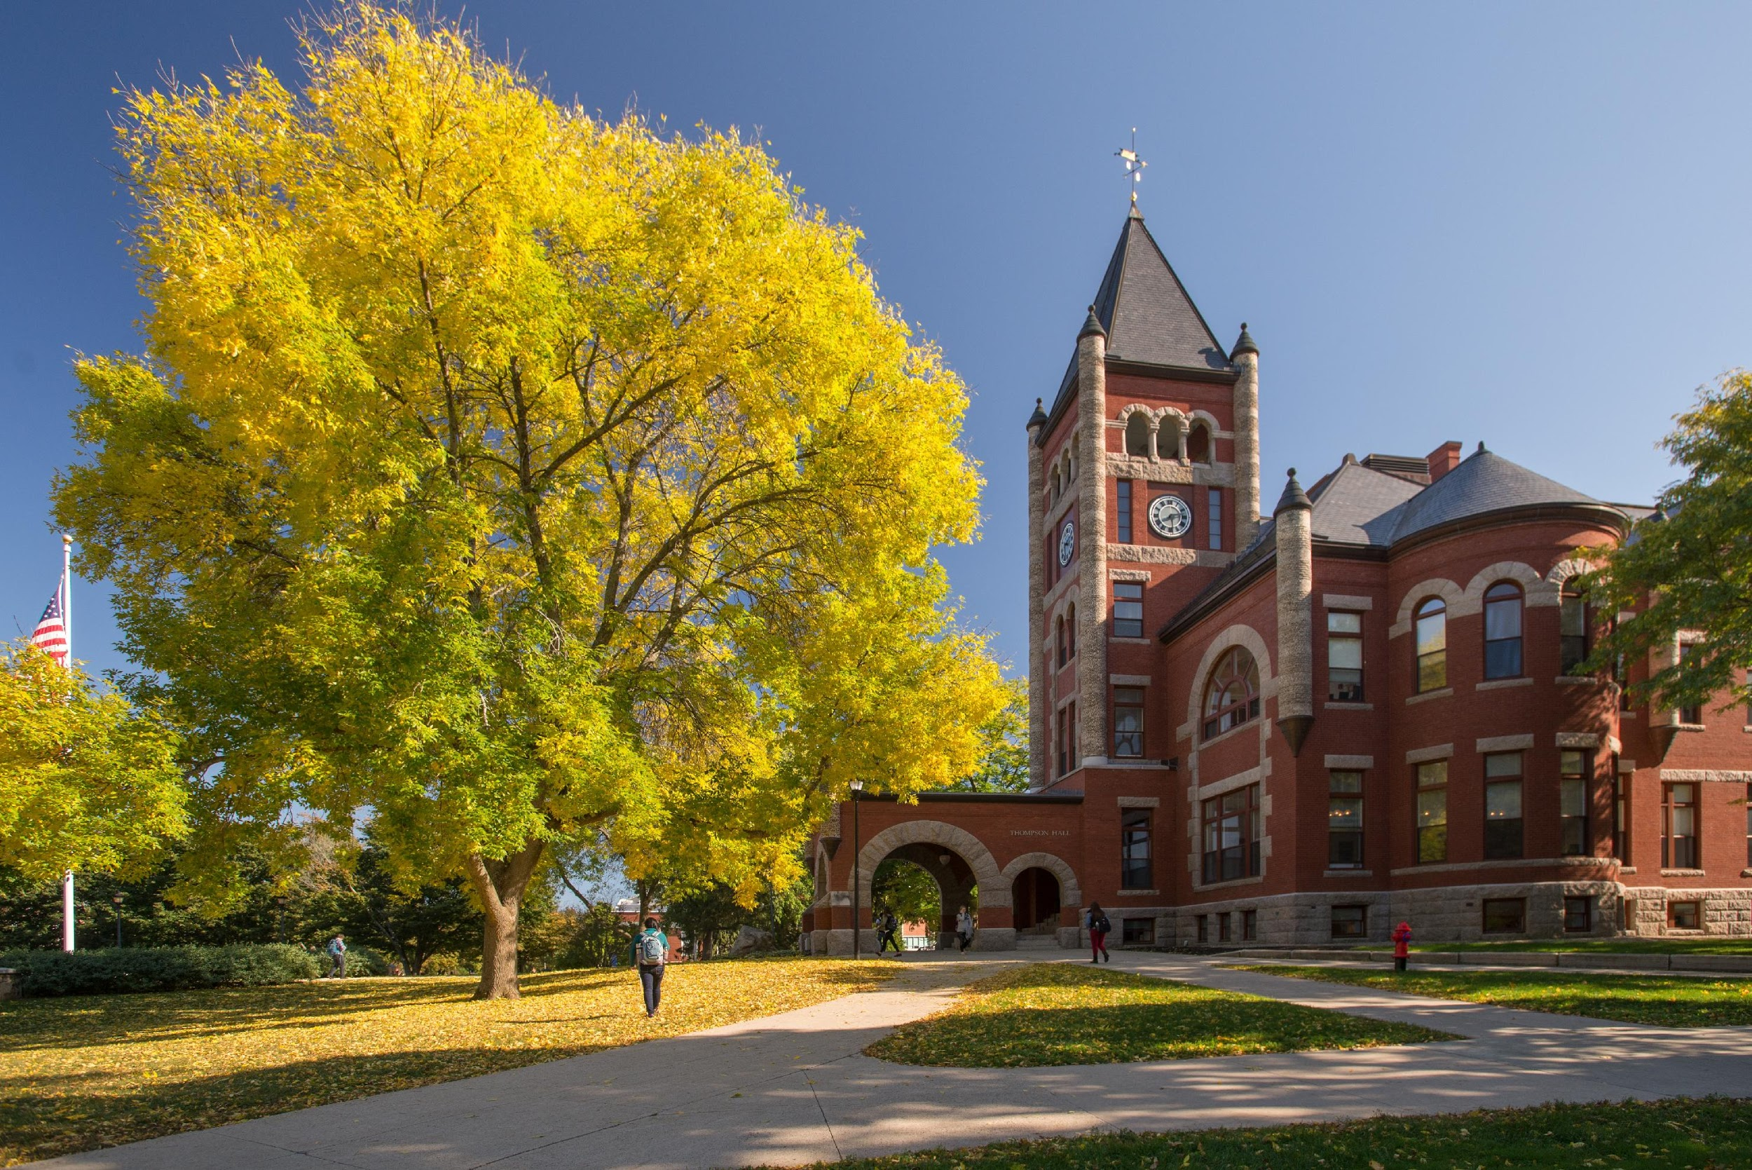
Mission
To support students with intellectual disability to achieve academic, life, and career goals.
UNH-4U supports students through a person-centered planning process, individualized courses of study, immersion in college life, and meaningful employment supports. UNH-4U also works to increase access to higher education for students with intellectual disability across the state of New Hampshire.

Slide 5

What is UNH-4U?
2-year (4 semester) inclusive higher education program at UNH
Students
  Take classes
  Have the opportunity to live on campus
  Engage in campus activities
  Work towards employment

Slide 6
Eligibility

Slide 7
Eligibility for UNH-4U
Ages 18-24 (will not turn 26 before end of 2-year program)
Student has a documented intellectual disability
  Students can have additional diagnoses
  Students can have co-occurring developmental disabilities
  We can help you determine if a student has intellectual disability

Slide 8
Who is best served by UNH-4U?
Young adults who…
Have identified a career goal and/or area of interest
Motivated to engage in academics and work
Are interested in an immersive academic and social experience
Can manage their daily routines with minimal support

Slide 9
UNH-4U Program Model

Slide 10
Program Model
Person-Centered Plan
Employment v Community-living v Quality of life
Individualized academic programming
Employment preparation and experiences
Campus life
(events, student organizations, residential life)
Outcomes
Employment
Competitive, integrated, fulfilling
Community-living
Independent living
Community engagement
Self-determination
Self-awareness
Problem solving
Goal pursuit
Notes:
The UNH-4U program model starts with a person-centered plan. This plan includes the student’s vision for employment, community living, and the components that they believe compose a good quality of life after college. We then use this plan to develop plans for individualized academic programming, employment experiences, and engagement in campus life (attending events, being involved in clubs and residential life).
We also ensure that academic programming and employment experiences are linked, so students have the skills they need. We believe that this individualized programming will support student outcomes in three areas: 1) Competitive, integrated, and fulfilling employment; 2) Community-living-this includes living as independently as a student wants to live and being engaged in their community; and 3) Self-determination, this includes skills such as self-awareness, problem solving, and goal pursuit.

Slide 11
Person-Centered Approach
Notes:
Person-centered approach to higher education planning; Strength based; deep dive into person-centered planning, building their self efficacy, informed decision-making and building their confidence and career aspirations based on their personal strengths and passions, and then build a program of study and support-system around them to optimize success.
Our staff team has and will continue to work closely with Student Accessibility Services, Residence Life, Housing, Dean of Students and others to ensure risks are mitigated and student success is optimized. As a self advocate once said in our UNH-4U retreat, “Life skills don’t happen in a life skills class, they happen through living.”

Slide 12
Typical Weekly Activities
Type of Activity | Weekdays | Weekends
Academic/ Employment | Classes (4/semester) Meetings with academic coaches Advisory meetings Study Work | Study Work
Social | Meetings with campus ambassadors Residential hall Campus activities Hang out with friends | Hang out with friends Campus activities

Slide 13
Student Employment
Spring Year 2
Career exploration
On-campus employment
On/off-campus employment and/or internship
Off-campus employment and/or internship
Fall Year 2
Spring Year 1
Fall Year 1

Slide 14





Student Status & Credential Attainment
Registered as continuing education students
Students receive an audit transcript
5 digital badges available upon completion of the 2-year program
Notes:
The digital badges we are producing:
Correspond to 21st century skill sets
Relate to competency-based education and training
Are targeted to student and advisory identified interests; and,
Validate student knowledge and skills.
Your classes will include other topics that you are interested in- not just about the hard stuff – but a key focal point will be about what job you want to do in your future and helping you to become a confident adult.

Slide 15
Student Supports

Slide 16
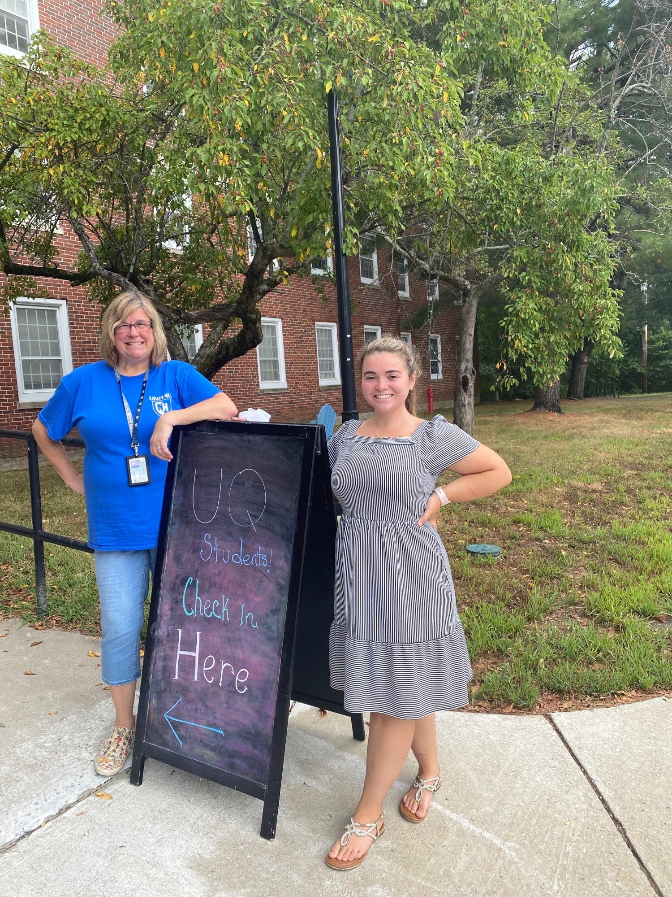
UNH-4U Professional Team
Director
Inclusion Facilitator
Employment Specialist
Student Support Coordinator
Program Support
Evaluator

Slide 17

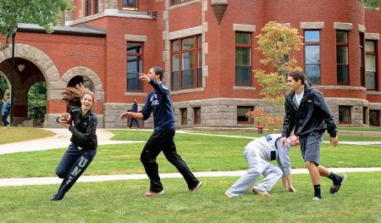
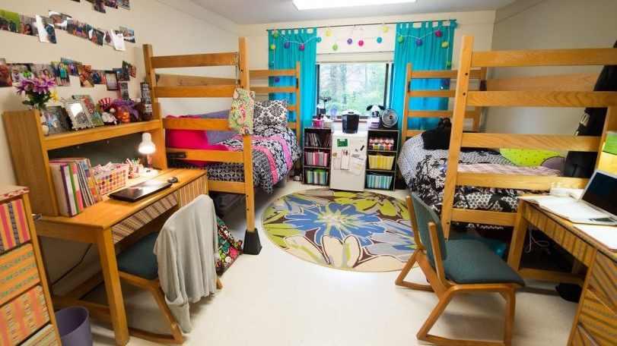
Peer Supports
Academic Coach: Assists students with assignments, projects, quizzes, organizing materials, managing info.
Campus Ambassador: Assists students with navigating campus, participating in activities, joining clubs, going to sports events, and connecting with peers.
Residential Student Assistant (RSA): Like a traditional RA in the dorm but hired and supervised through UNH-4U and assigned to work specifically with UNH-4U students.

Slide 18

UNH Supports & Collaboration
Student Accessibility Services: Individualized accommodation process
Residential Life:
Hall Director & RA

Slide 19
Supports Unavailable
Support for self-care (e.g., hygiene)
Medicine administration
Independent living routines (e.g., getting ready in the morning, laundry)
***Many students receive supports for these activities through Family Managed Employees, paid for through Medicaid budgets

Slide 20
Service Coordination & Paying for UNH-4U

Slide 21
Service Coordination
Monthly meetings with service teams
  Vocational Rehabilitation
  Area Agency/Developmental Disability Services
Transition planning
Support for tuition, fees, and supports

Slide 22
Annual Costs for Students/Families
Student type | Cost | Items
Residential Students | $14,900 | Housing Meal plan Fees
Commuter Students | $1,000-$3,000* | Parking Fees *Meal plan (costs vary depending on meal plan)
Students/families are also responsible for purchasing textbooks
Scholarship opportunities

Slide 23
Total Annual Costs
Item | Cost | Typical payer
Tuition | $2,200 | Vocational Rehabilitation
Student fees | ~$900 | Families
Housing | ~$9,000 | Families
Meal plan- residential | ~$5,000 | Families
Meal plan- commuter (optional) | $500-$1,800 | Families
Parking –commuter | $75 | Families
Textbooks | Varies | Families
Academic Coaching | $9,600 | Vocational Rehabilitation
Campus Ambassadors | $9,000 | Area Agency/DDS
Notes:
Costs typically covered
$21,700

Slide 24
VR Referral and Area Agency Coordination
Referral and Release of Information
Application
Review Documents
Interviews & Assessments
Determination of eligibility

Slide 25
Application Process

Slide 26

Application Timeline
Application
Interview
Decision
Due early January
March/April
Mid-April

Slide 27
Application Requirements
Release of information so information can be shared by Vocational Rehabilitation, your Area Agency/DDS, and/or school
Recommendations that can speak to career interests and why UNH-4U is a good fit for you!
  Vocational Rehabilitation Counselor
  2 other references
Documentation of intellectual disability

Slide 28
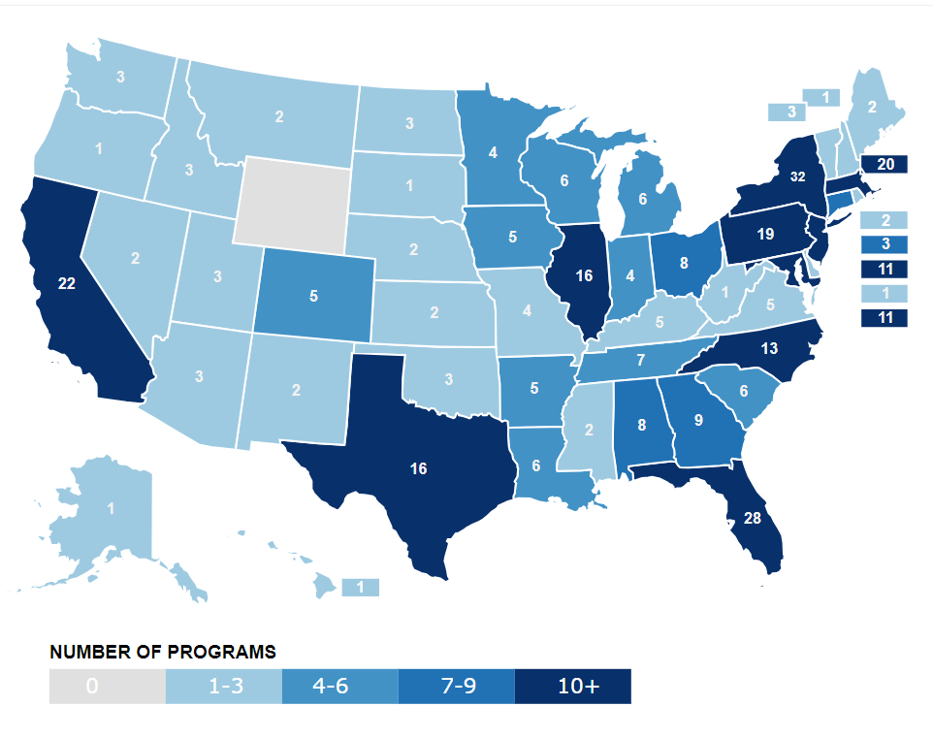
Other options…
Find an inclusive post secondary program near you with the
Think College search tool

Slide 29

Contact us
Website: iod.unh.edu/unh-4u
Email: unh4u.durham@unh.edu

