Slide 1
Making the Job Safer
Lesson 3

Slide 2
Lesson 3: Objectives
By the end of this lesson, you will be able to:
Describe several ways to lessen or even get rid of certain workplace hazards.
Explain which methods are most effective in controlling hazards.
Describe the steps you should take to protect yourself from common workplace hazards and know that following safe work practices is very important.
List types of personal protective equipment (PPE) that are used to protect your hands, face, head, eyes, ears, and feet from hazards and reduce your risk of getting sick and say what the PPE protects you from.

Slide 3
What is a Hazard – Review
A hazard is something that can hurt you, make you sick, or stress you out.
All workplaces have hazards.

Slide 4
John

Slide 5
HAZARDS IN THE PICTURE: John
Hazard:
Possible Solutions:

Slide 6
Hazards in the picture: John - Answers
Put up caution signs and tell workers not to walk through the wet areas. Clean up spills quickly. Train workers what to do if they see a spill on the floor. Install nonslip flooring.
Use floor mats. Wear non-slip shoes. Figure out what is causing the slippery floor and fix that problem. Ask for help. Tell a boss.

Slide 7
BILL

Slide 8
HAZARDS IN THE PICTURE: Bill
Hazard:
Ways to Fix It:

Slide 9
Safe Lifting Techniques: guide
Picture Credit: Kjell Thorsson, https://www.mobiletruckrental.com.au/lifting-heavy-objects/

Slide 10
Safe Lifting Techniques: Video

Slide 11
WORKPLACE ERGONOMICS
Notes:
FILL IN

Slide 12
Mary

Slide 13
HAZARDS IN THE PICTURE: Mary
Hazard:
Ways to Fix It:

Slide 14
Ann

Slide 15
HAZARDS IN THE PICTURE: Ann
Hazard:
Ways to Fix It:

Slide 16
Chemical hazards – eye wash station

Slide 17
COVID-19

Slide 18
Covid-19: CDC Guidelines
Stay at least 6 feet away from people outside your home.
Stay away from people who are sick.
Wear a mask to protect everyone.
Your mask must cover your nose, mouth, and chin.
The mask must be snug on your face.
Make sure breathing is easy.
Wash your hands often with soap and water.
Sing the happy birthday song twice while washing your hands.
Use hand sanitizer if that is all you have.
Rub the hand sanitizer all over your hands and rub them until they feel dry.
Washing your hands with soap and water is best.

Slide 19
PPE Grab Bag Activity

Slide 20
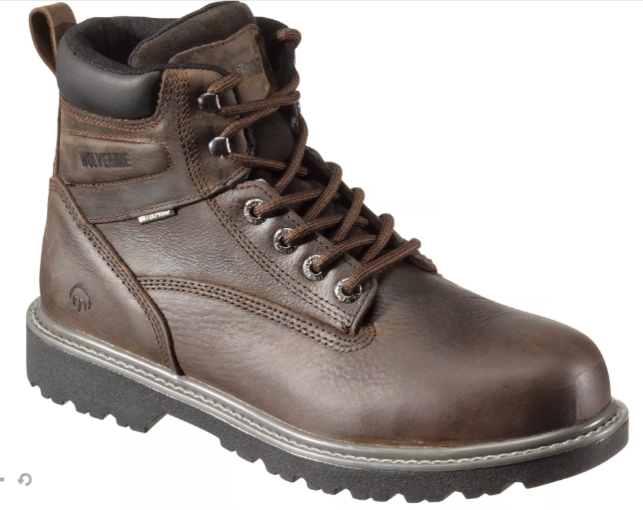
What is the PPE? 1

Slide 21
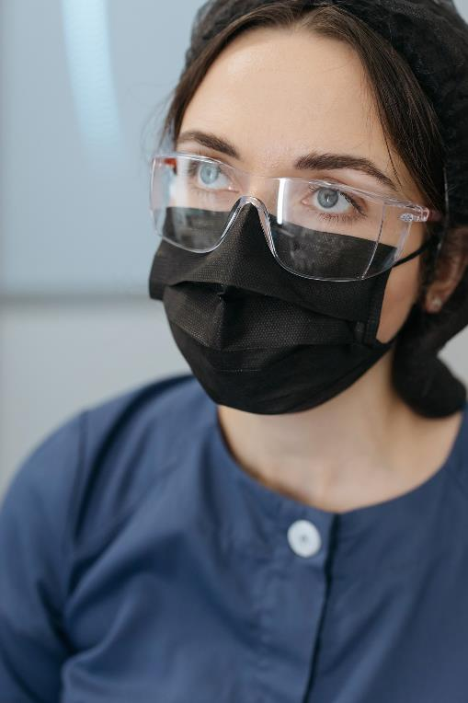
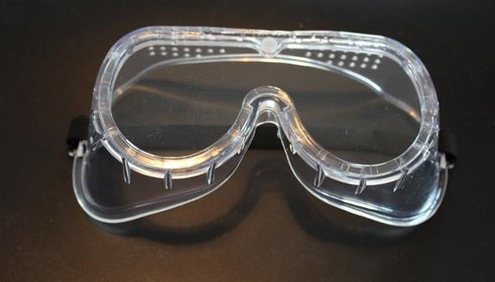
What is the PPE? 2

Slide 22
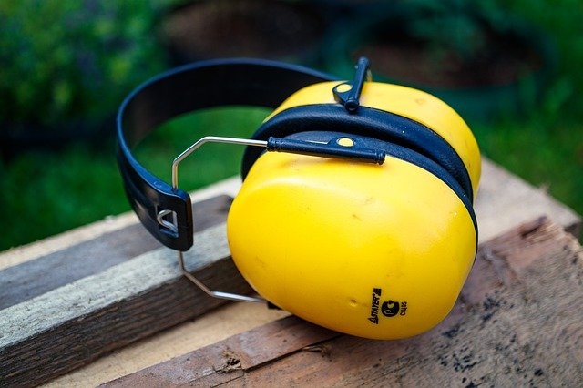
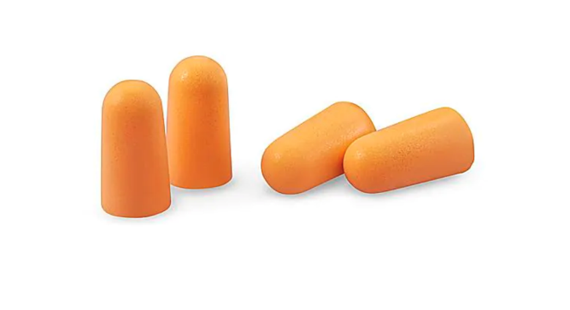
What is the PPE? 3

Slide 23
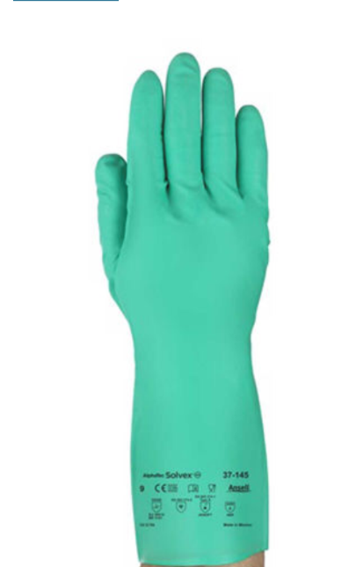
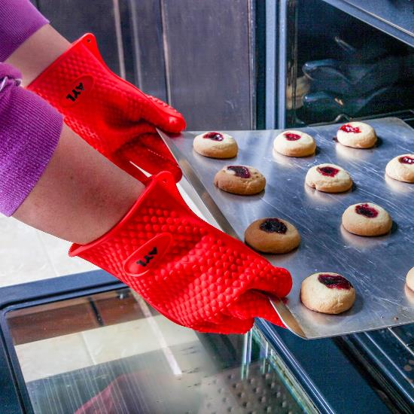
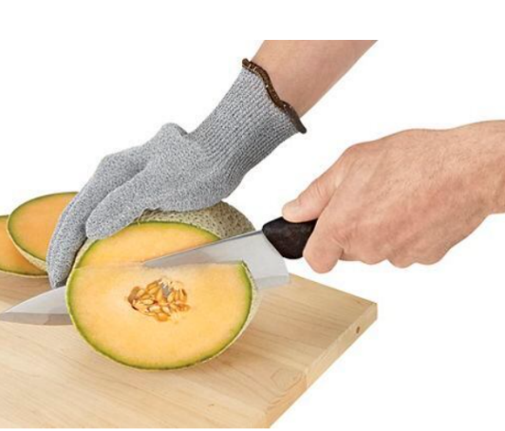
What is the PPE? 4

Slide 24
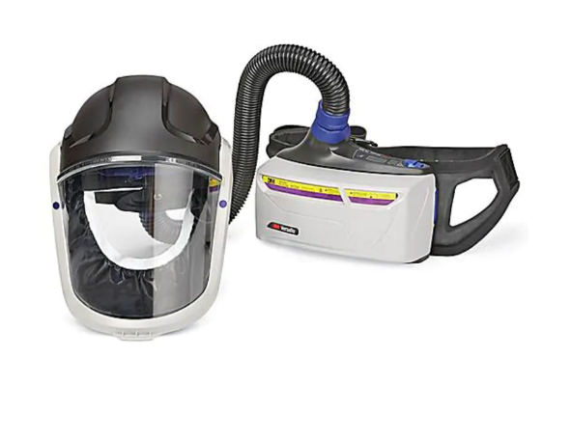
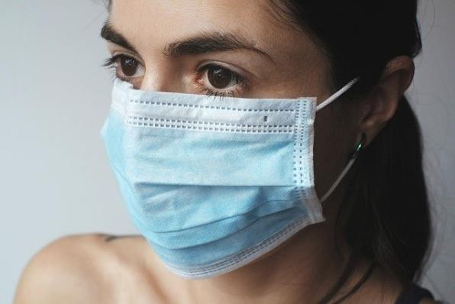
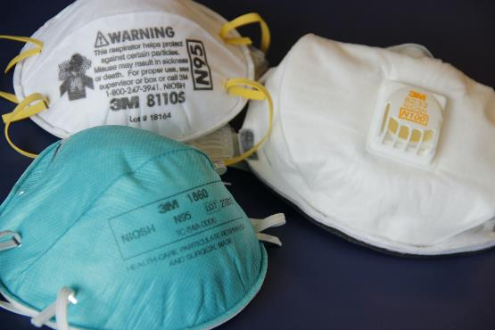
What is the PPE? 5

Slide 25
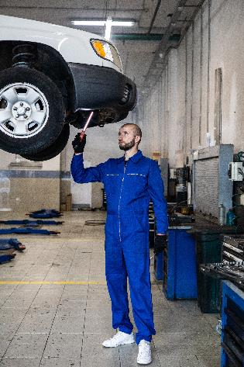
What is the PPE? 6

Slide 26
What is the PPE? 7

Slide 27
Donning (Putting on) PPE

Slide 28
Doffing (Taking off) Ppe

